Slide 1
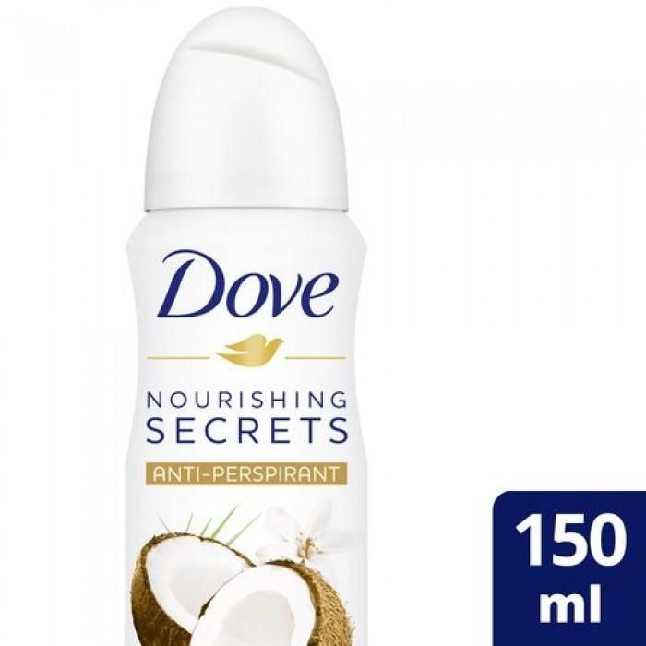
Dove
Dove anti-sweat spray with coconut and jasmine 150 ml
SAR 36.80 Q
- Deodorant is a good option for the start of your day. It also contains a cream that helps your underarm skin recover from irritation from shaving.
- You will get a beautifully underarm area in just three days.
- Provides 24-hour protection for the armpit area, and a long-term sense of security.
- Does not contain alcohol.
- Sensitive armpit skin helps to recover from irritation caused by shaving

Slide 2
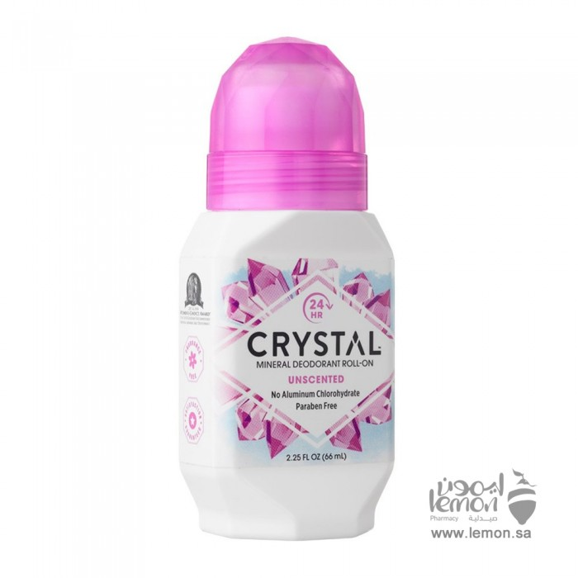
Crystal
Crystal deodorant natural unscented 66 ml
27.38 SAR. Q
Crystal's deodorant consists of mineral salts that prevent body odor by creating an invisible protective barrier against aromatherapy bacteria.
This deodorant does not stick to the body, does not cause stains and does not leave white residue, can be used by men and women, and prevents body odor for 24 hours

Slide 3
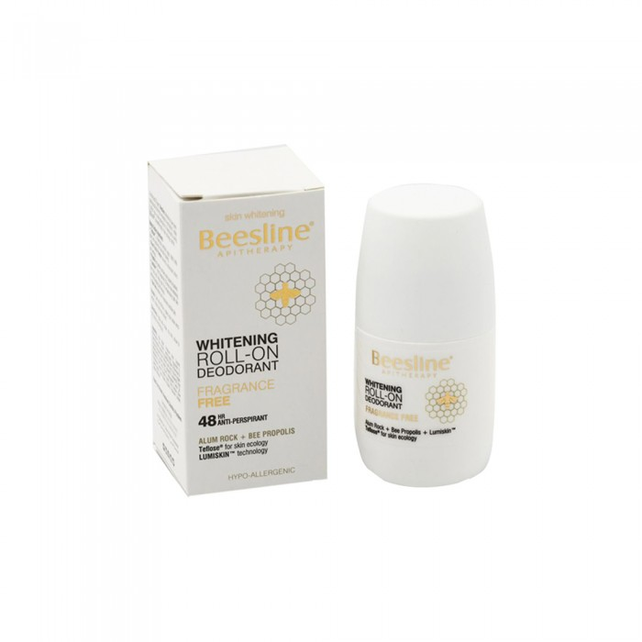
Paislin
Bezlin Deodorant Roll Free Fragrance 50ml
SAR 50.89. Q
Beislin perfume-free deodorant is an innovative, safe and highly effective deodorant for 48 hours that combats body odour, absorbs moisture and moisturizes the skin while lightening the skin and unifying its evening colour for a clean and bright underarm area. It fights body odors and soothes skin after shaving. Absorbs unpleasant wetness. Bleaches skin and reduces the appearance of skin spots. Gentle and moisturize skin.

Slide 4
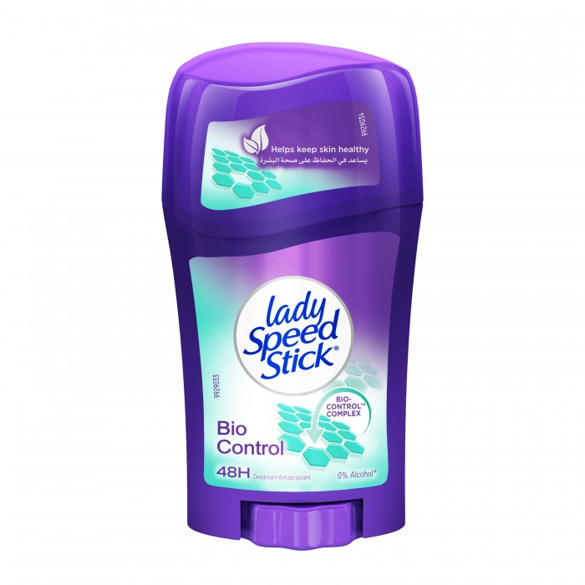
Lady Speed
Lady Speed Steak Deodorant Bayou Control 45 g
SAR 19.55. Q
How to Use
Wrap the base of the steak packaging to take the product out of the packaging and pass it two to three times on each armpit

Slide 5
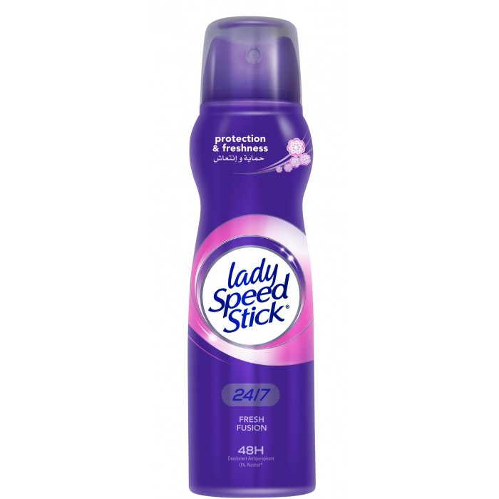
Lady Speed Steak
Lady Speed Steak Spray Deodorant Fresh Fusion For Ladies 150 ml
17.25 SAR. Q
The deodorant and antiperspirant spray Lady Speed ensures you dry and has no effect on clothes, giving you 24 hours protection with a natural refreshing odour, available in the form of a 150 ml spray and thanks to its exquisite quality its picturesque expression will continue to accompany you throughout the day and increase your confidence. This deodorant is unique to the rejuvenating formula of the rejuvenating adorable aroma as this formula distances the annoying smell and sweat for longer, and more importantly, it does not leave white marks and remains transparent.

